Slide 1
Jenkins Continuous Build System

Slide 2
Executive summary
Continuous integration systems are a vital part of any Agile team because they help enforce the ideals of Agile development
Jenkins, a continuous build tool, enables teams to focus on their work by automating the build, artifact management, and deployment processes
Jenkins’ core functionality and flexibility allow it to fit in a variety of environments and can help streamline the development process for all stakeholders involved

Slide 3
Agenda
Continuous Integration (CI)
What is it?
What are the benefits?
Continuous Build Systems Jenkins What is it? Where does it fit in?
Why should I use it?
What can it do?
How does it work?
Where is it used?
How can I get started?
Putting it all together Conclusion References

Slide 4
CI - Defined
“Continuous Integration is a software development practice where members of a team integrate their work frequently, usually each person integrates at least daily - leading to multiple integrations per day. Each integration is verified by an automated build (including test) to detect integration errors as quickly as possible” – Martin Fowler

Slide 5
CI – Benefits
Immediate bug detection No integration step in the lifecycle A deployable system at any given point Record of evolution of the project

Slide 6
Jenkins
Branched from Hudson
Java based Continuous Build System
Runs in servlet container Glassfish, Tomcat
Supported by over 400 plugins SCM, Testing, Notifications, Reporting, Artifact Saving, Triggers, External Integration
http://jenkins-ci.org/

Slide 7
Jenkins - History
2005 - Hudson was first release by Kohsuke Kawaguchi of Sun Microsystems
2010 – Oracle bought Sun Microsystems Due to a naming dispute, Hudson was renamed to Jenkins Oracle continued development of Hudson

Slide 8
How Jenkins works
- Setup When setting up a project in Jenkins, out of the box you have the following general options: Associating with a version control server Triggering builds Polling, Periodic, Building based on other projects Execution of shell scripts, bash scripts, Ant targets, and Maven targets Artifact archival Publish JUnit test results and Javadocs Email notifications
As stated earlier, plugins expand the functionality even further

Slide 9
How Jenkins works
- Building
Once a project is successfully created in Jenkins, all future builds are automatic
Building
Jenkins executes the build in an executer By default,
Jenkins gives one executer per core on the build server Jenkins also has the concept of slave build servers Useful for building on different architectures Distribution of lo

Slide 10
How Jenkins works - Reporting
Jenkins comes with basic reporting features Keeping track of build status Last success and failure “Weather” – Build trend
These can be greatly enhanced with the use of pre-build plugins Unit test coverage Test result trending Findbugs, Checkstyle, PMD

Slide 11
Jenkins by example –
Project Status Project status pages provide more details about a given project The status of the last several builds Charting (depending on plugins) Dependencies

Slide 12
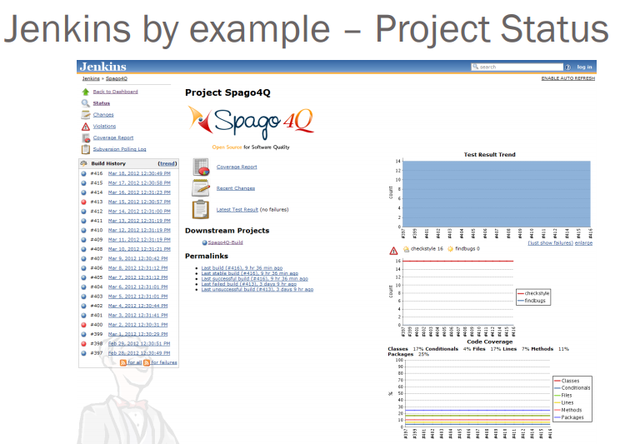

Slide 13
Conclusion
Continuous integration is a necessity on complex projects due to the benefits it provides regarding early detection of problems
A good continuous build system should be flexible enough to fit into pre-existing development environments and provide all the features a team expects from such a system
Jenkins, a continuous build system, can be an integral part of any continuous integration system due to it’s core feature set and extensibility through a plugin system

